Slide 1
EASY SHOPPING SYSTEM

Slide 2
UNIVERSITY OF KARACHI DEPARTMENT OF COMPUTER SCIENCE
GROUP MEMBERS :
Zain Munir
Faiq Ehsan
Ramish Hussain
Omar Faheem
Hamza Iqbal Mallick
COURSE SUPERVISOR : DR. HUMERA TARIQ

Slide 3

INTRODUCTION

Slide 4
PROBLEM STATEMENT
The objective of the project is to do the online shopping. Online shopping is the process whereby consumers directly buy goods,services etc. from a seller interactively in real-time without an intermediary service over the internet.
From our “EASY SHOPPING SYSTEM” shoppers can visit web stores from the comfort of their homes and shop as they sit in front of the computer and can buy a variety of items from online stores. In fact, people can purchase about anything any product like books,clothing,household appliances and many other products from an online store.

Slide 5
IMPORTANCE
To solve the given problem is important because it provides as many facilities like:
1)CONVENIENCE: Shopping online is convenient . You don’t need to get dressed or to wait for the store to open. You can easily visit their website, find the product you want and buy it without getting out of your home.
2)Variety : Shopping online allows you to find many products that you wouldn’t be able to find in a physical store.
3)Save Time : With just a couple of clicks of the mouse, you can purchase your shopping orders and instantly move to other things , which can save time

Slide 6
EASY SHOPPING SYSTEM PROJECT INCLUDES FOLLOWING THINGS:
It includes all the four principles of “OBJECT ORIENTED PROGRAMMING”
It includes filing
Searching, sorting ,insertion, deletion in list is also included

Slide 7
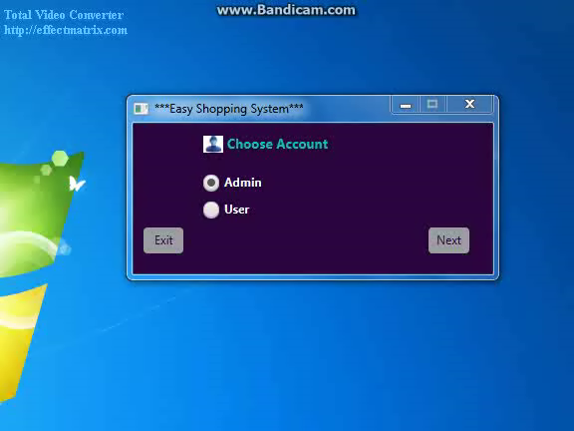
DEMO

Slide 8
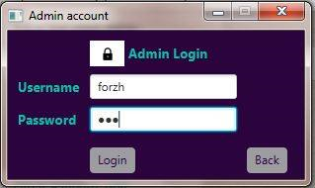
SAMPLE INPUT
Here username and password is taken as input

Slide 9
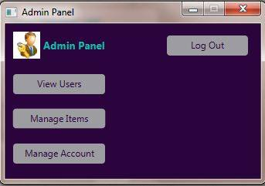
SAMPLE OUTPUT
As admin login his/her account admin pannel will be shown as output to admin to proceed further.

Slide 10
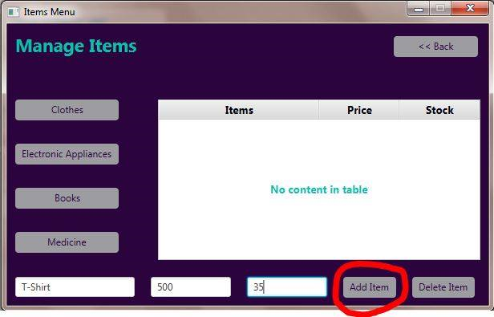
Sample Input
Let suppose if admin chooses to manage items then he will be able to add or delete different items in their respective list.
As you can see here the type of cloth, the price of that cloth and stock of that cloth is entered by admin so after that…

Slide 11
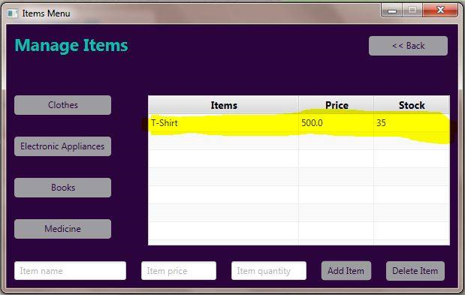
SAMPLE OUTPUT
So after entering that all that information is displayed in their respective pannel
Like T-shirt In items pannel, 500 in price pannel and 35 in stock pannel and so on will be don further.

Slide 12
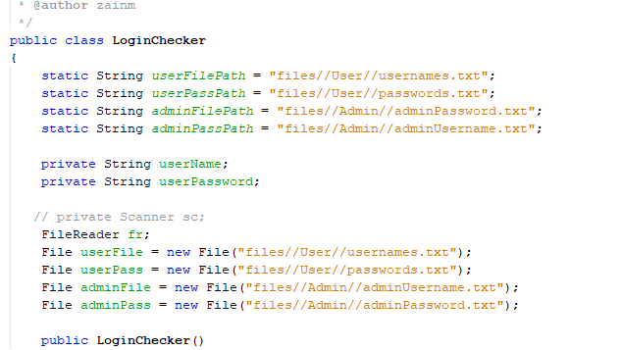
FILING
Filing is all about reading,writing or creating files. In this project we have used all these features i.e :
Creating a file
Writing in a file
Reading from file
Searching in a file

Slide 13
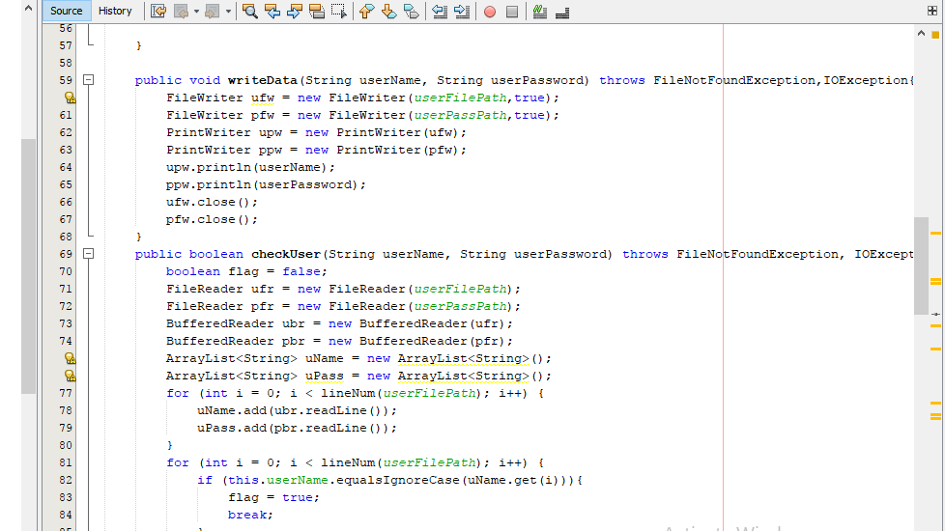

Slide 14
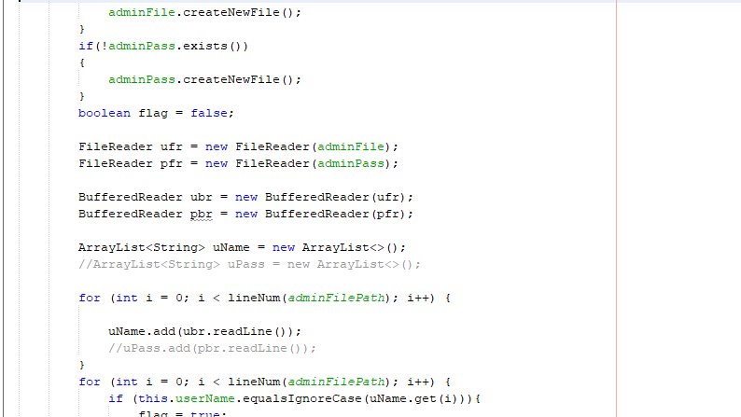

Slide 15
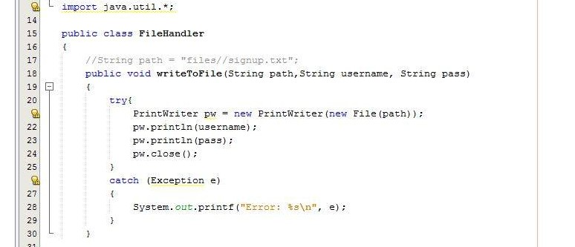

Slide 16
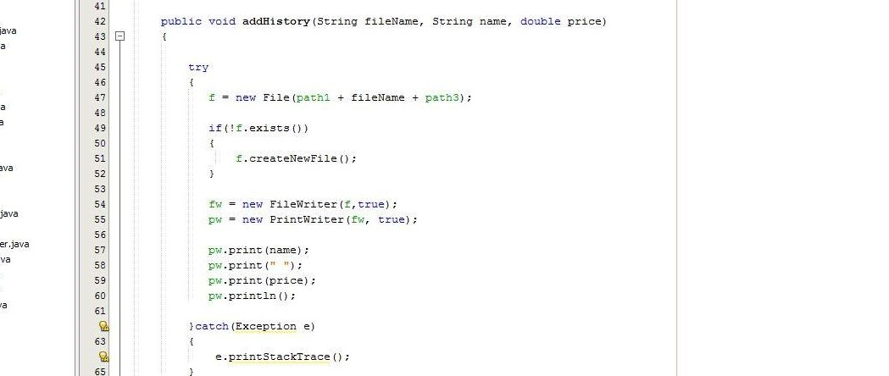

Slide 17


ATTRIBUTE HANDLING
We keep atributes
Private because to implement the concept of encapsulation
Static because so that it can be shared among shared classes
Final because it cannot be changed

Slide 18
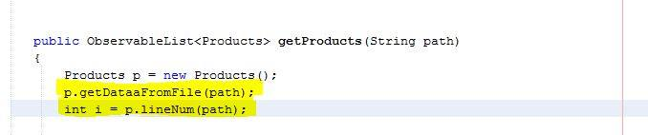
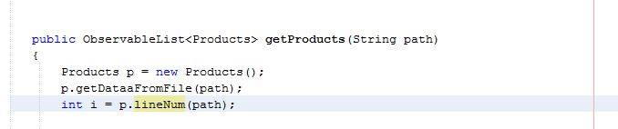
CONSTRUCTOR CALLING AND FUNCTION CALLING
FUNCTION CALLING

Slide 19
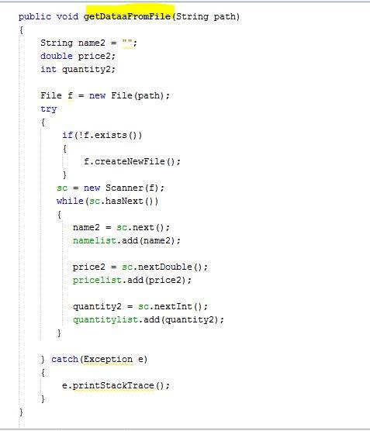

Slide 20
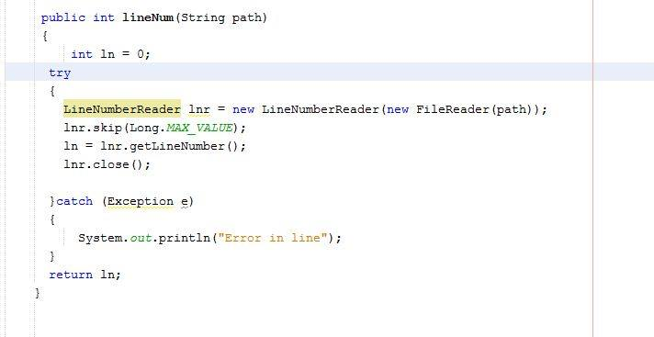

Slide 21

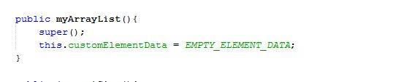
CONSTRUCTOR CALLING

Slide 22
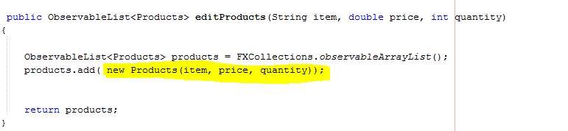
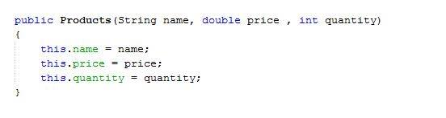

Slide 23
OVERLOADING

Slide 24
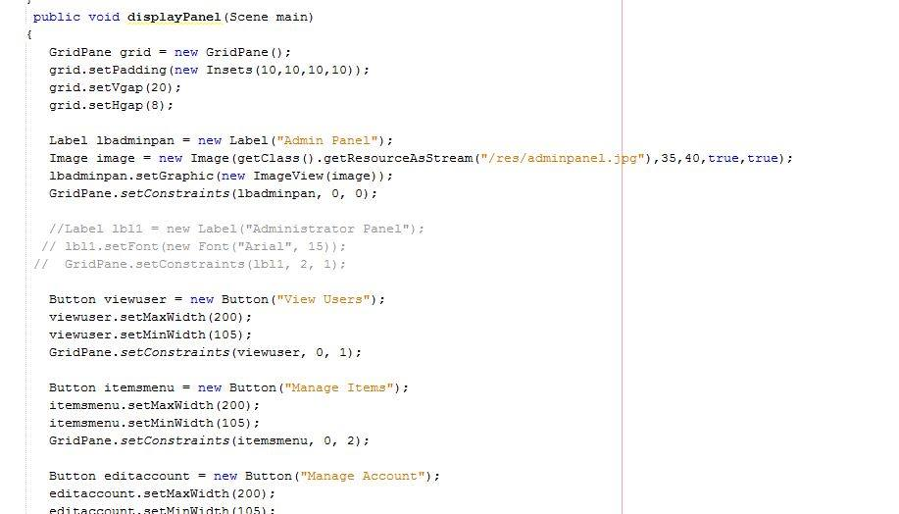

Slide 25
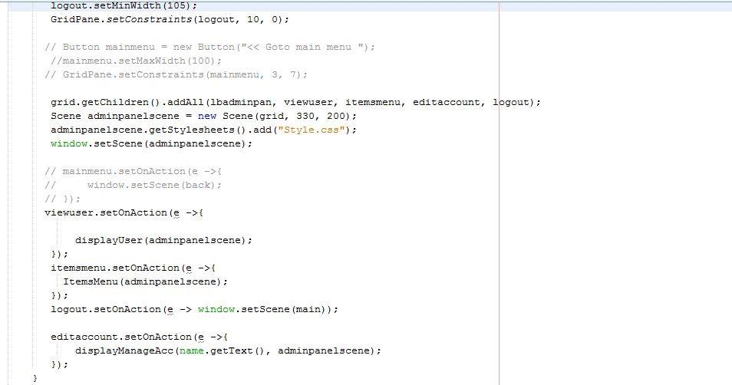

Slide 26
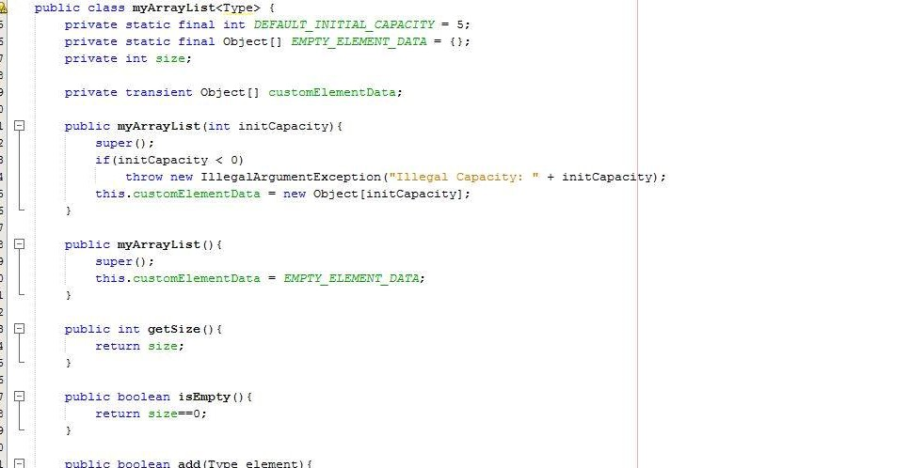
ARRAY OF SIMILAR OBJECTS

Slide 27
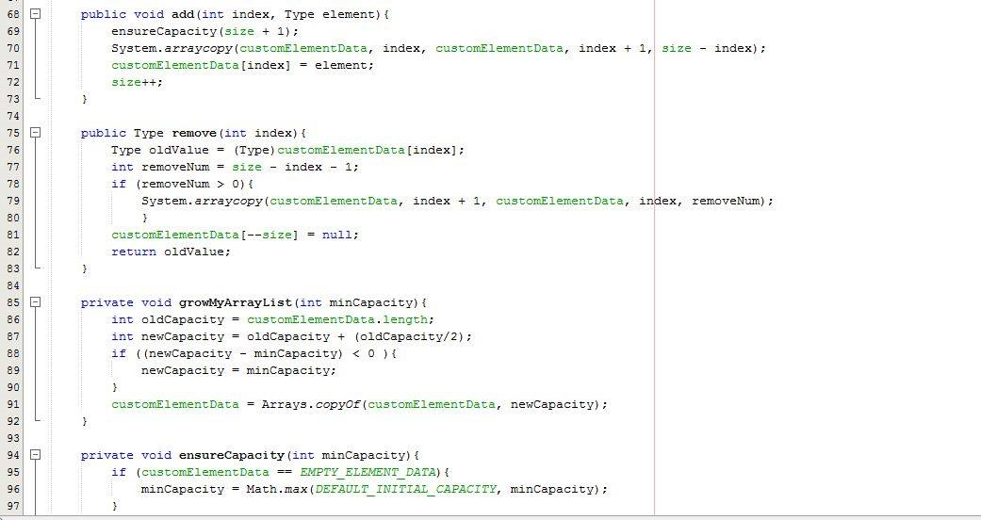

Slide 28
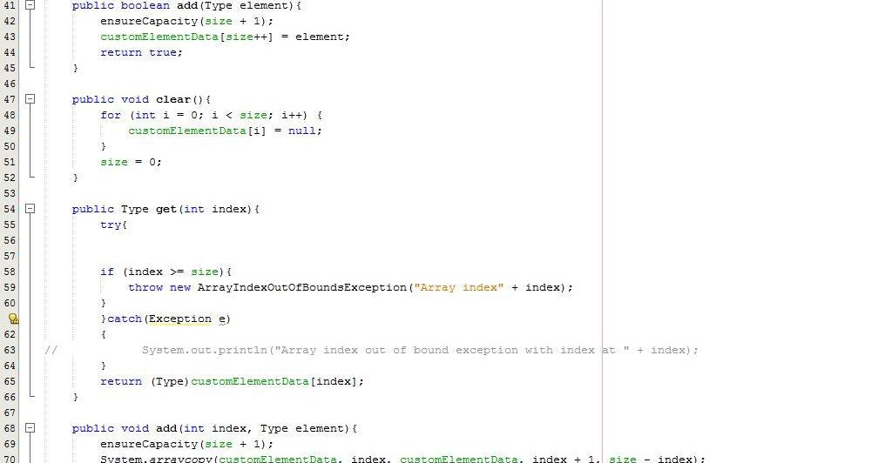

Slide 29
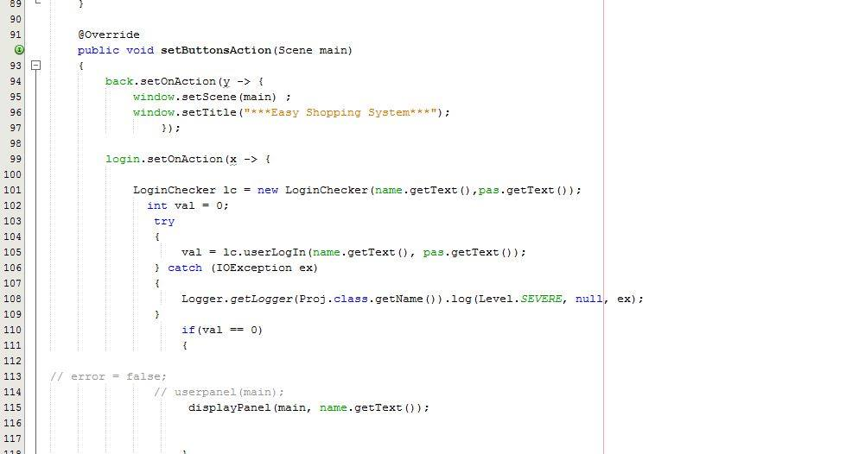
INHERITANCE /ABSTRACTION/ OVERRIDING
OVERRIDING

Slide 30
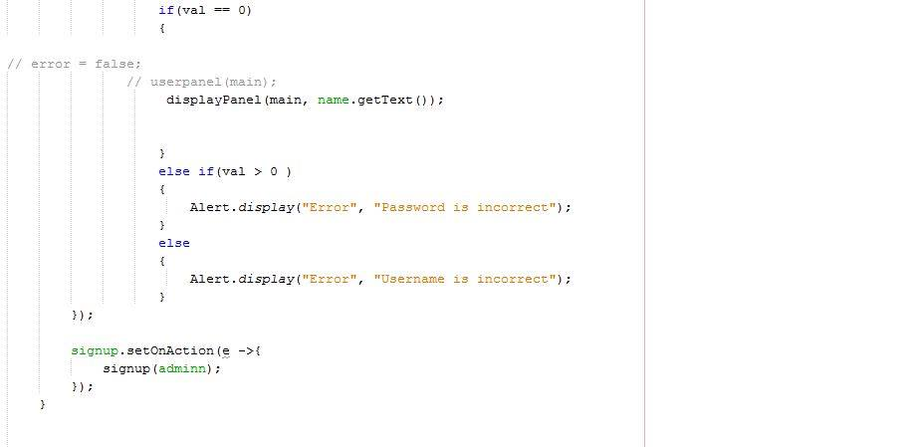
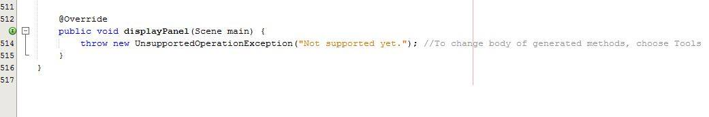

Slide 31
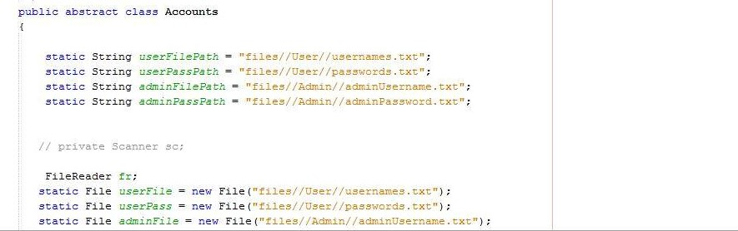
INHERITANCE

Slide 32
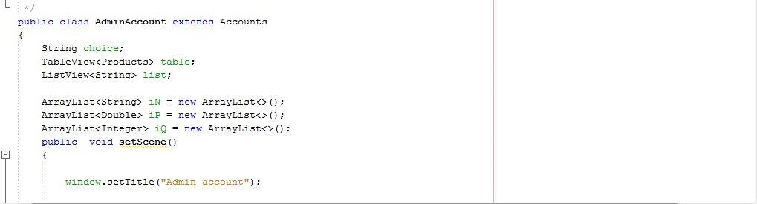

Slide 33
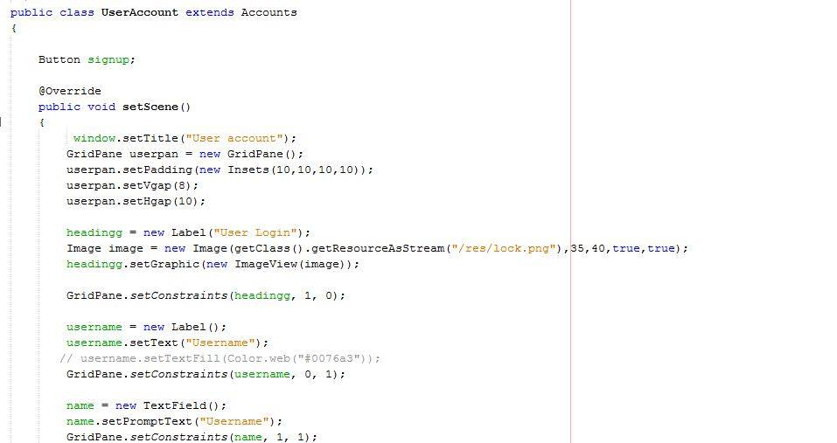

Slide 34
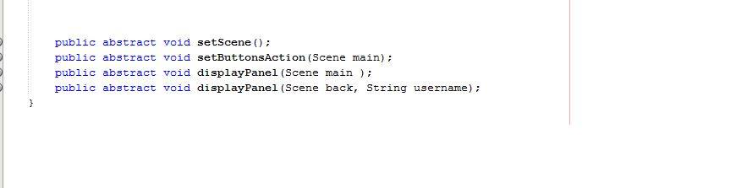
ABSTRACTION

Slide 35
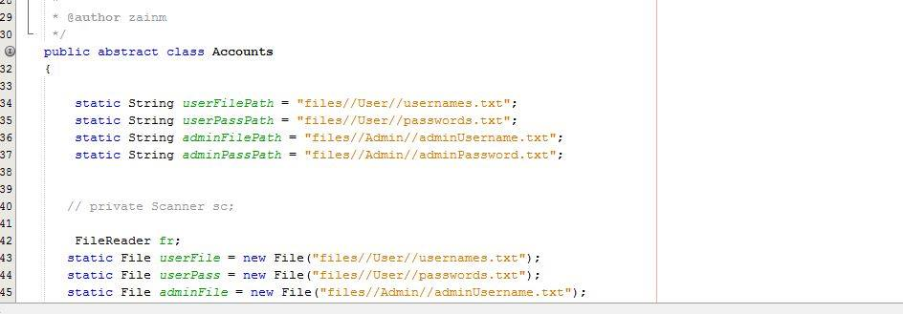

Slide 36
DISCRETE MATHEMATICS

Slide 37
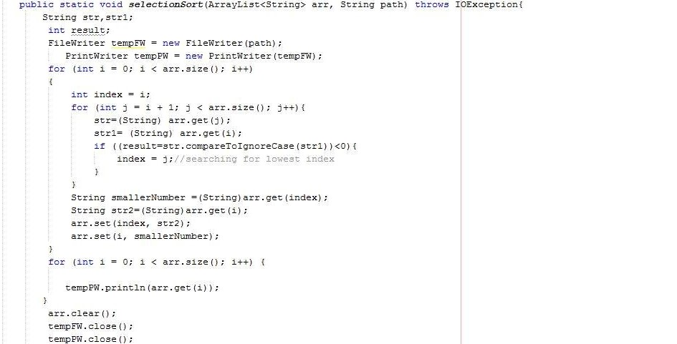
SELECTION SORTING

Slide 38
LEARNING AND ACHIEVEMENTS
1)JAVA FX
2)ARRAY LIST
3)SORTING
4)FILING

Slide 39
IMPROVEMENTS AND FUTURE WORKS
1)Thinking to upgrade as mobile application
2)Graphs
3)Price range

Slide 40
THANKYOU !!

